Slide 1
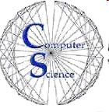

CS 235: User Interface Design March 10 Class Meeting
Department of Computer Science San Jose State University Spring 2015 Instructor: Ron Mak
www.cs.sjsu.edu/~mak

Slide 2
Schedule for Prototype Presentations
Thursday, March 12
Innovative Designers
Team Four
Thundercats
Tuesday, March 17
Unknown
UXability
X Factor

Slide 3
Prototype Presentation Reports
A short report:
What is your application.
What UI design patterns did you use and why.
Describe up to 5 patterns.
Screen shots that illustrate your design patterns.
Your PowerPoint slides, if any.
Your prototype code, if runnable by anyone.
Include installation and how to run instructions.
Due Friday, April 3 (after Spring Break)

Slide 4
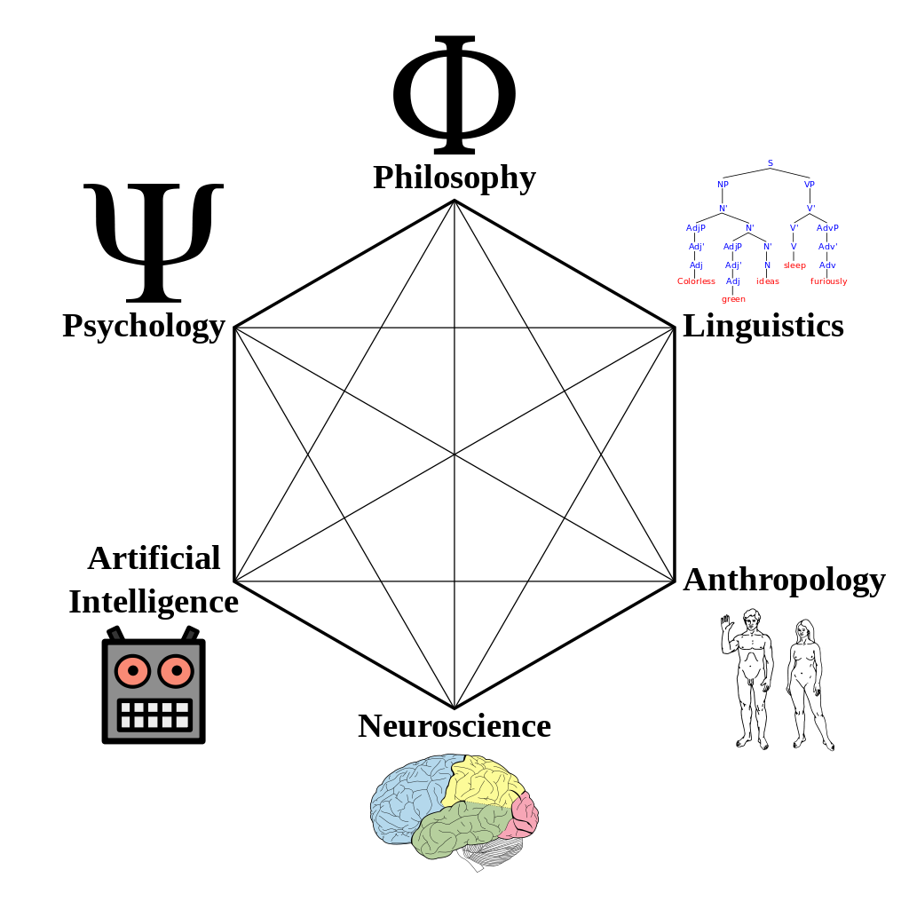
Cognitive Science
The interdisciplinary study of the mind, intelligence, and behavior.
How does the mind process information?
perception
language
memory
reasoning
emotion
http://en.wikipedia.org/wiki/Cognitive_science

Slide 5
Hand-Eye Coordination
Pointing at objects on a display and moving pointers along constrained paths follow consistent, quantitative laws.

Slide 6
Fitts’s Law for Pointing at Displayed Targets
Where:
T = time to move to the target
D = distance to the target
W = width of the target
a = a measure of the ease of starting and stopping the movement
b = a measure of the average difficulty of moving the hand and pointing the device

Slide 7
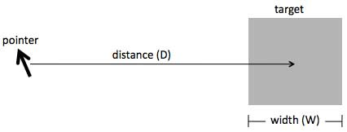
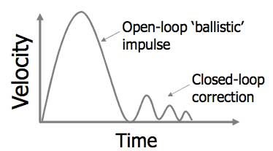
Fitts’s Law, cont’d
Velocity over time as the pointer moves to the target:
Designing with the Mind in Mind, 2nd ed. by Jeff Johnson
Morgan Kaufmann, 2014

Slide 8
Fitts’s Law, cont’d
Users hit on-screen targets faster the closer and larger the targets are.
The more the distance decreases or the target size increases, the less the decrease in pointing time.
Beyond a certain size, making the target even larger adds little benefit.
Below a certain distance, making the target closer doesn’t help much.

Slide 9
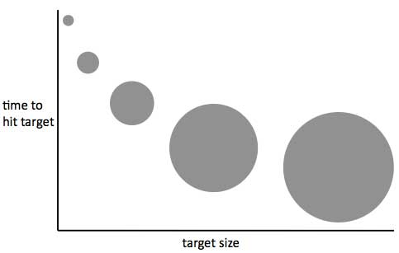
Fitts’s Law, cont’d
Designing with the Mind in Mind, 2nd ed. by Jeff Johnson
Morgan Kaufmann, 2014

Slide 10
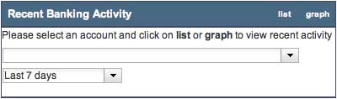
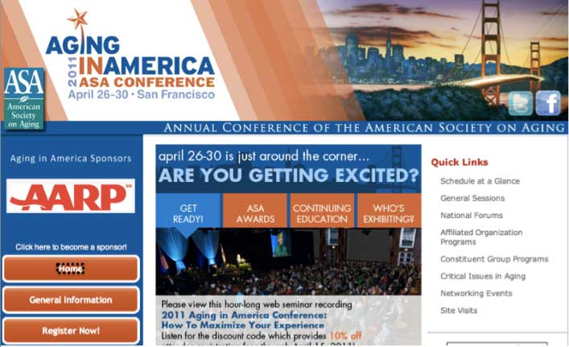
Targets Too Small
Designing with the Mind in Mind, 2nd ed. by Jeff Johnson
Morgan Kaufmann, 2014

Slide 11
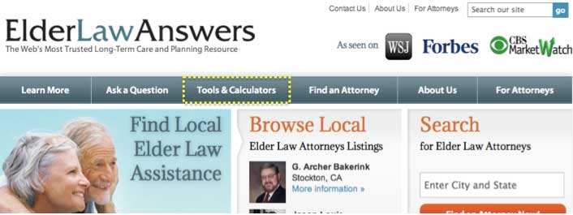
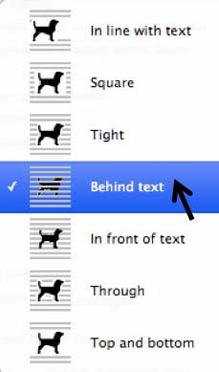
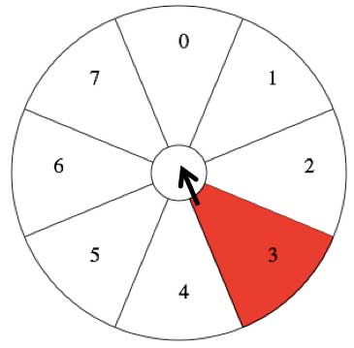
Larger Target Sizes
Designing with the Mind in Mind, 2nd ed. by Jeff Johnson
Morgan Kaufmann, 2014

Slide 12
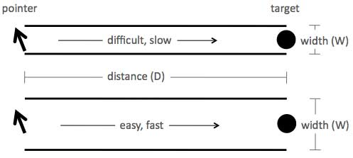
Steering Law
If you must keep a pointer within a certain confined path while moving it to a target, then the wider the path, the faster you can move the pointer to the target.
Designing with the Mind in Mind, 2nd ed. by Jeff Johnson
Morgan Kaufmann, 2014

Slide 13
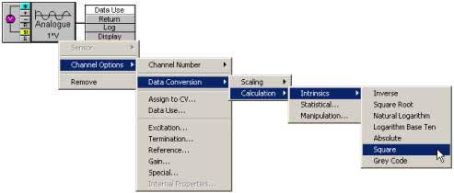
Steering Law, cont’d
Difficult: Multi-level pull-right menus:
Designing with the Mind in Mind, 2nd ed. by Jeff Johnson
Morgan Kaufmann, 2014

Slide 14
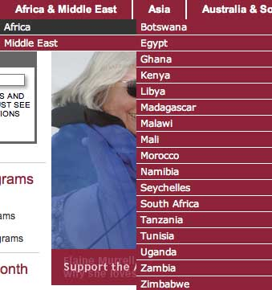
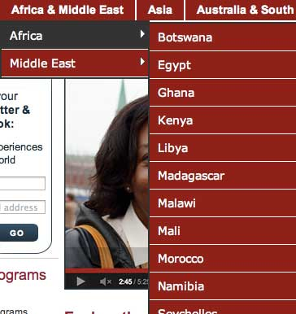
Steering Law, cont’d
Original
Improved
Designing with the Mind in Mind, 2nd ed. by Jeff Johnson
Morgan Kaufmann, 2014

Slide 15
How Your Brain Learns
Brain plasticity: Your brain learns a new perception or behavior by rewiring itself.
Neurons that previously fired independently connect into a network and fire in concert.
Neurons that were formerly in one network can join another network. _

Slide 16
How Your Brain Learns, cont’d
You perform the first few times of an activity in a highly controlled and conscious manner.
The neural network forms after you’ve practiced. Then the activity becomes automatic.
We learn faster when:
Practice is frequent, regular, and precise.
Operation is task focused, simple, and consistent.
Vocabulary is task focused, familiar, and consistent.
Risk is low.

Slide 17
Frequency of Practice
Consider frequency of practice when designing the UI for an interactive system.
Example: Bank ATM
Used by a person every few days or weeks.
Present a short list of goals (withdraw, deposit, etc.)
Guide the user to achieve a goal.
Example: Email reader
Used frequently by a person.
Help and tips can be shown on demand only.

Slide 18
Regularity of Practice
Habits form faster if practiced regularly, such as daily.
Skipping a practice session now and then isn’t detrimental.
Skipping a lot of practice significantly slows habit formation.
Therefore, design your application’s UI to encourage people to use it regularly.

Slide 19
Precision of Practice
Precise practice trains neuron networks to fire in concert with less “noise”.
The more carefully and precisely a person practices an activity, the more systematic and predictable the activation of the neural network.
Design the UI of an application to
Help people become precise, such as by providing guides and grids.
Encourage people to use it purposefully and carefully by providing a clear conceptual model.

Slide 20
Task Focused, Simple, and Consistent
“Gulf of execution”: The gap between what an application user wants and the application’s operations.
Design applications that match what users want to do.
Perform a task analysis.
Design a task-focused conceptual model consisting mainly of object-action pairs.
Design a UI based strictly on the task analysis and the conceptual model.

Slide 21
Task Analysis
What are the users’ goals for this application?
What tasks should the application support?
Which tasks are common or important?
What are the steps of each task?
What are the results and outputs of each task?
How are the results and outputs used?
Who does which task?
What terminologies do they use?
What problems do users have performing tasks?

Slide 22
Conceptual Model
Users build a model in their minds of how to use an application and how the application works.
A conceptual model of an application is the one that designers want users to understand.
Try to match as closely as possible the models of the users and the designers.
Focus the conceptual model on tasks.

Slide 23
Conceptual Model, cont’d
Make the model as simple as possible with fewer concepts for users to learn.
Example of excess complexity: Separate concepts that are too similar.
Membership: Your company paid for a customer support service.
Subscription: Your company subscribed to a customer support newsletter.
Access: Which areas of the customer support website users in your company can access.
Entitlements: Services provided at each level.

Slide 24
Consistency
Users learn faster if an application is consistent and predictable.
Unpredictability forces a user to constantly be learning something new.
UI designer’s goal: A conceptual model that is task focused, simple, and consistent.
Conceptual consistency
Keystroke consistency

Slide 25
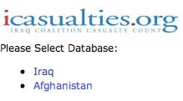
Task Focused Vocabulary
Example: Website for investment transactions that allows users to save templates locally or to a database on a remote server.
Example: An insurance company for military veterans asks for a database instead of for a country.
Bad: Not task focused | Good: Task focused
local | private
database | shared, public
Designing with the Mind in Mind, 2nd ed. by Jeff Johnson
Morgan Kaufmann, 2014

Slide 26
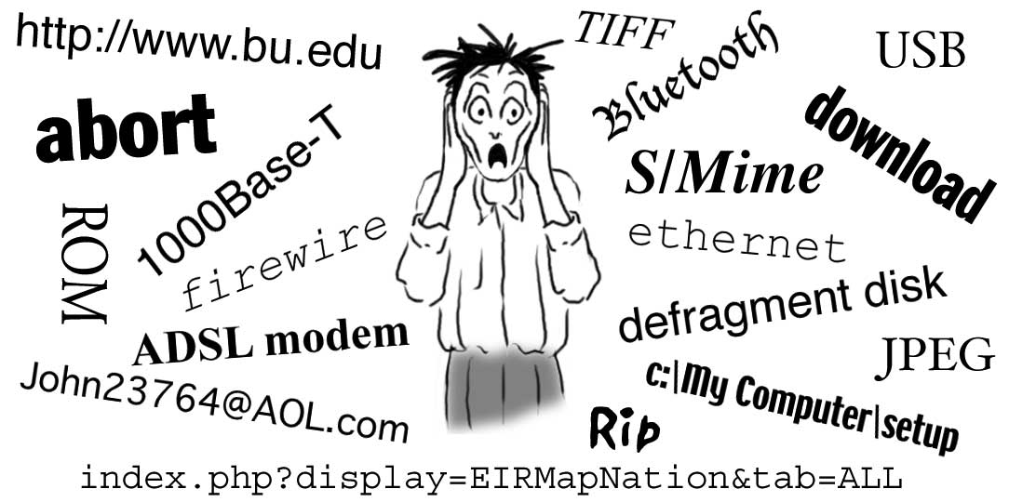
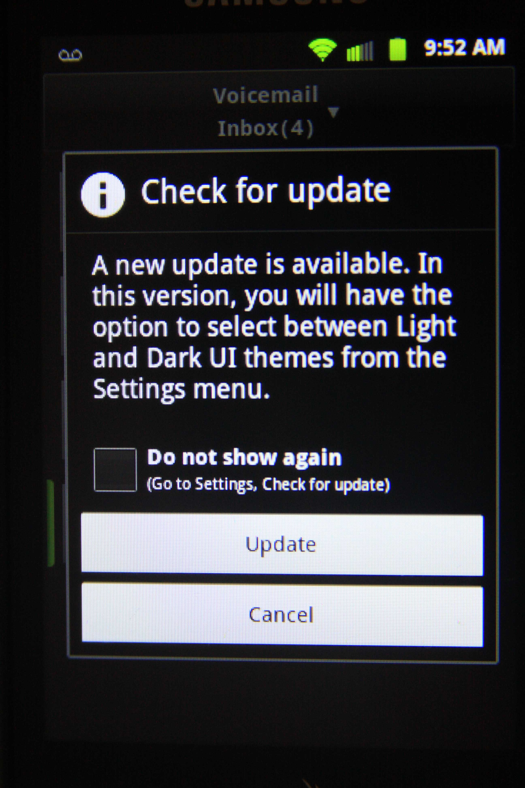
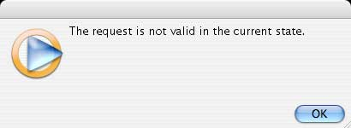
Avoid Geek Speak
Designing with the Mind in Mind, 2nd ed. by Jeff Johnson
Morgan Kaufmann, 2014

Slide 27
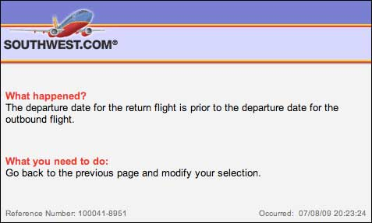
Avoid Geek Speak, cont’d
Example: Error messages that are task focused and clear, which fosters learning.
Designing with the Mind in Mind, 2nd ed. by Jeff Johnson
Morgan Kaufmann, 2014

Slide 28
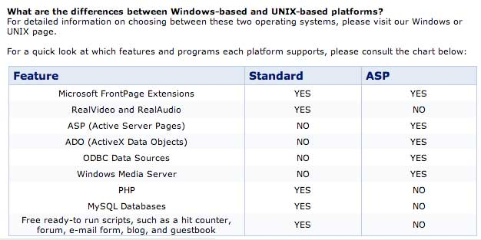
Use Consistent Terminology
Terminology is consistent when each concept has one and only one name.
Same name, same thing; different name, different thing.
Example of inconsistent terminology:
Designing with the Mind in Mind, 2nd ed. by Jeff Johnson
Morgan Kaufmann, 2014

Slide 29
Lower the Risk of Using the Application
Users will explore more and learn more if the application has less risk.
Users may be afraid to use unfamiliar features.
Don’t make it easy for users to make mistakes.
Prevent user errors where possible.
Make errors easy to detect.
Tell users clearly what they did wrong.
Allow users to undo wrong actions easily.

Slide 30
The Perception of Time
Perceived responsiveness of an application is more important than effectiveness.
An application can have poor responsiveness even if it is fast.
How?

Slide 31
Responsive Application
Keep up with the user.
Don’t make the user wait unexpectedly.
Keep the user informed about the application’s status even if it cannot fulfill the user’s request immediately.
Let the user know immediately that input was received.
Indicate how long an operation will take.

Slide 32

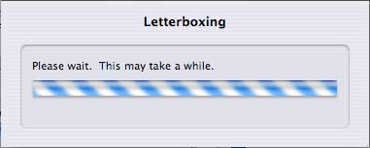
Responsive Application, cont’d
Allow the user to do other things while waiting.
Manage queued events intelligently.
Perform low-priority tasks in the background.
Anticipate a user’s most common requests.
Good:
Poor:
Designing with the Mind in Mind, 2nd ed. by Jeff Johnson
Morgan Kaufmann, 2014

Slide 33
Busy Indicators
Display busy indicators for any operation that blocks further user actions even if the function executes quickly.
Example: hourglass cursor

Slide 34
Progress Indicators
Display for any operation that takes longer than a few seconds.
Show work remaining, not just work completed.
Show total progress, not just the current step.
Show percentage of operation completed.
Start at 1%, not 0%.
Don’t display 100% for more than 1-2 seconds.
Show smooth progress, not erratic bursts.
Use human scale precision: “about 4 minutes”, not “240 seconds”

Slide 35
Delays
Delays between unit tasks of a large operation are less annoying than delays within unit tasks.
A user keeps the ultimate goal of an operation in working memory.
Naturally relaxes between unit tasks.
Unexpected delays during unit tasks can cause a user to lose track what is happening.

Slide 36
Task Closure
Task closure: The difference between the impact of delays during and between unit tasks.
High level of closure
Less sensitive to response time delays.
Example: Saving a file
Low level of closure
Most sensitive to response time delays.
Example: Typing a character and seeing it echoed on the screen.

Slide 37
Display Important Information First
Example: Open a document
Display the first page immediately rather than waiting for the entire document to load.
Example: Search results
Display found items immediately while continuing to search for more.
Example: Display a large downloaded image
Good: Display a complete low-resolution version first and then progressively improve the resolution.
Bad: Progressively display the full-resolution image.

Slide 38


Display Important Information First, cont’d
Good
Bad
Designing with the Mind in Mind, 2nd ed. by Jeff Johnson
Morgan Kaufmann, 2014

Slide 39
Animated Tasks
A user action may require rapid successive adjustments with hand-eye coordination until a goal is achieved.
If heavy computation is involved such as while moving a large image, feedback may lag user actions.
Fake the feedback by moving only a rubber-band outline of the image.

Slide 40
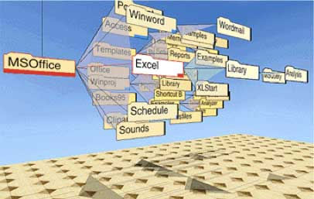
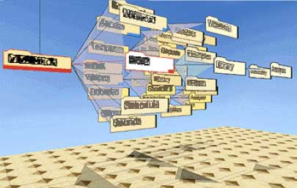
Animated Tasks, cont’d
Example: A rotating “cone tree” renders labels as blobs.
Designing with the Mind in Mind, 2nd ed. by Jeff Johnson
Morgan Kaufmann, 2014

Slide 41
Work Ahead
Stay ahead of the user whenever possible.
An application can use low-load periods to pre-compute responses to high-probability requests.
Example: Search for a word in a document
While displaying a find, search for the next occurrence of the word.
Example: Display a document
Render the next page while displaying the current page.

Slide 42
Prioritize User Actions
Process user actions by priority, not by the order they were received.
An interactive application should reorder tasks in its queue.
Simply executing tasks in the order they were received can waste resources and create extra work.
Reordering tasks can make work more efficient.
Example: Web browser
If the user clicks the “back” or “stop” button, immediately abort loading the current page.

Slide 43
Timely Websites
Minimize the number and size of images.
Provide quick-to-display thumbnails or overviews of large amounts of content.
Allow the user to drill down for more detail.
Use Cascading Style Sheets (CSS).
Use built-in browser dialog boxes.
Use browser-side scripting and applets.

